Slide 1

Movies: Performance versus Cost analysis
Aaron Drexler

Slide 2

Focus of analysis
Looking at 2 elements
Cost of Movie
Benefit of Movie
Look at how a movie performs
Analysis for movie company executives
Benefits for this data

Slide 3
Data Source
https://www.kaggle.com/code/muhammetgamal5/tmdb-5000-movies/notebook
Data pulled from the Movie Data Base

Slide 4
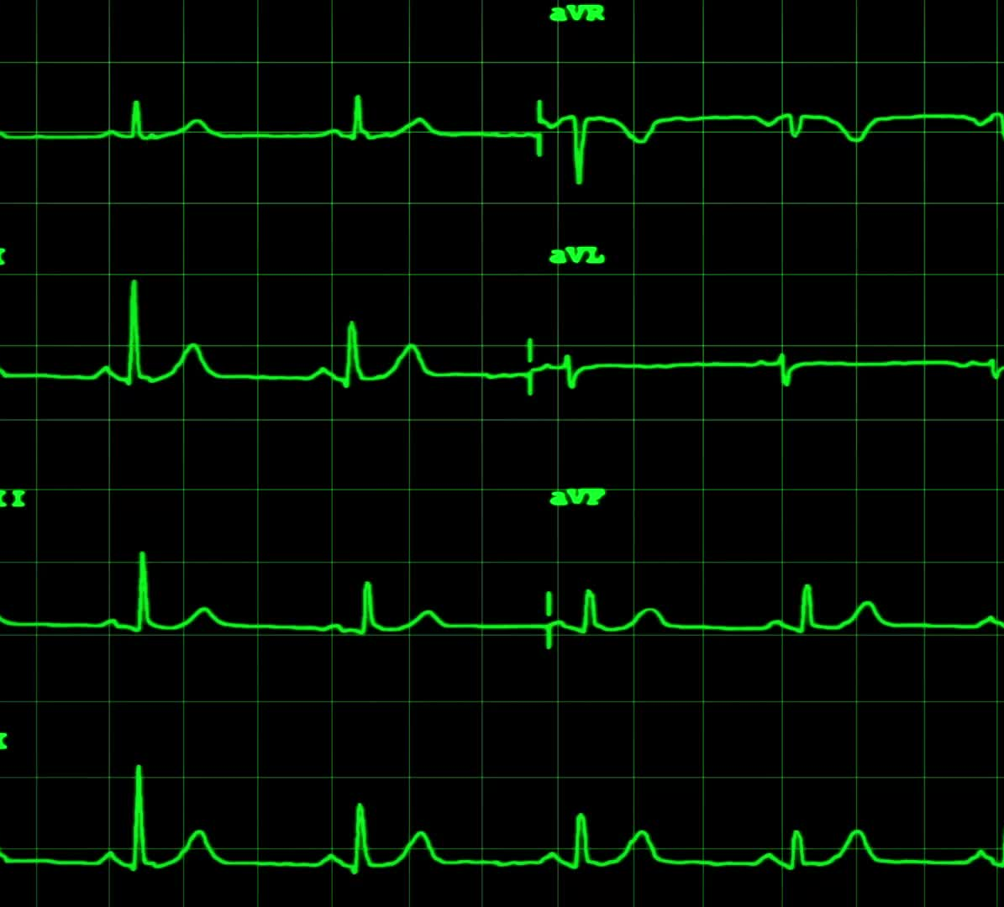
Plan of analysis
1) Going to compare and look correlation
2) Plot residuals to check for homoscedasticity and look at the residuals
3) Linear Regression
4) Visualization Types:
Pearson Correlation Heat Map
Residual Plot types
Linear Regression

Slide 5

R-Code
library(ggplot2)
getwd()
setwd("~/Documents/DSC 680")
##SET DIRECTORY
library(readr)
df <-read_csv("tmdb-movies.csv")
View(df)
##IMPORT DATA
df1<- df[, c('popularity','budget','revenue')]
View(df1)
##REDUCED VARIABLES TO THOSE WE WANT
profit <- df1$revenue-df1$budget
profit
##CREATED A NEW VARIABLE, JOINT EDUCATION LEVEL
df1$profit <- profit
View(df1)
##INSERT BACK INTO DF
corr <- round(cor(df1),2)
View(corr)
##FINDS CORRELATIONS OF VARIABLES
library(reshape2)
melted_corr <- melt(corr)
View(melted_corr)
##MELTS DATA TO BE ABLE TO PUT INTO HEAT MAP

Slide 6
R-Code Cont.
ggplot(data = melted_corr, aes(x=Var1, y=Var2, fill=value)) + geom_tile(color = "white")+
scale_fill_gradient2(low = "blue", high = "red", mid = "white",
midpoint = 0, limit = c(-1,1), space = "Lab",
name="Pearson\nCorrelation") + geom_text(aes(Var2, Var1, label = value), color = "black", size = 4) +
theme(
axis.title.x = element_blank(),
axis.title.y = element_blank(),
panel.grid.major = element_blank(),
panel.border = element_blank(),
panel.background = element_blank(),
axis.ticks = element_blank(),
legend.justification = c(1, 0),
legend.direction = "horizontal")+
guides(fill = guide_colorbar(barwidth = 7, barheight = 1,
title.position = "top", title.hjust = 0.5))
##GRAPHED MELTED DF INTO HEAT MAP

Slide 7
R-Code Cont.
install.packages("dplyr")
install.packages("caTools")
install.packages("ROCR")
##INSTALLING PACKAGES REQUIRED FOR LINEAR REGRESSION
library(dplyr)
library(caTools)
##loading packages
profit_lm <- lm(profit ~ popularity, data = df1)
summary(profit_lm)
##LINEAR REGRESSION MODEL
plot(profit_lm)
##Check for homoscedasticity
profit_graph<-ggplot(df1, aes(x=profit, y=popularity))+geom_point()+
geom_smooth(method="lm", col="red")+theme_bw() +
labs(title = "Movie profits VS popularity",
x = "Profit",
y = "Popularity")
profit_graph
##PLOT THE DATA WITH LINEAR REGRESSION MODEL

Slide 8
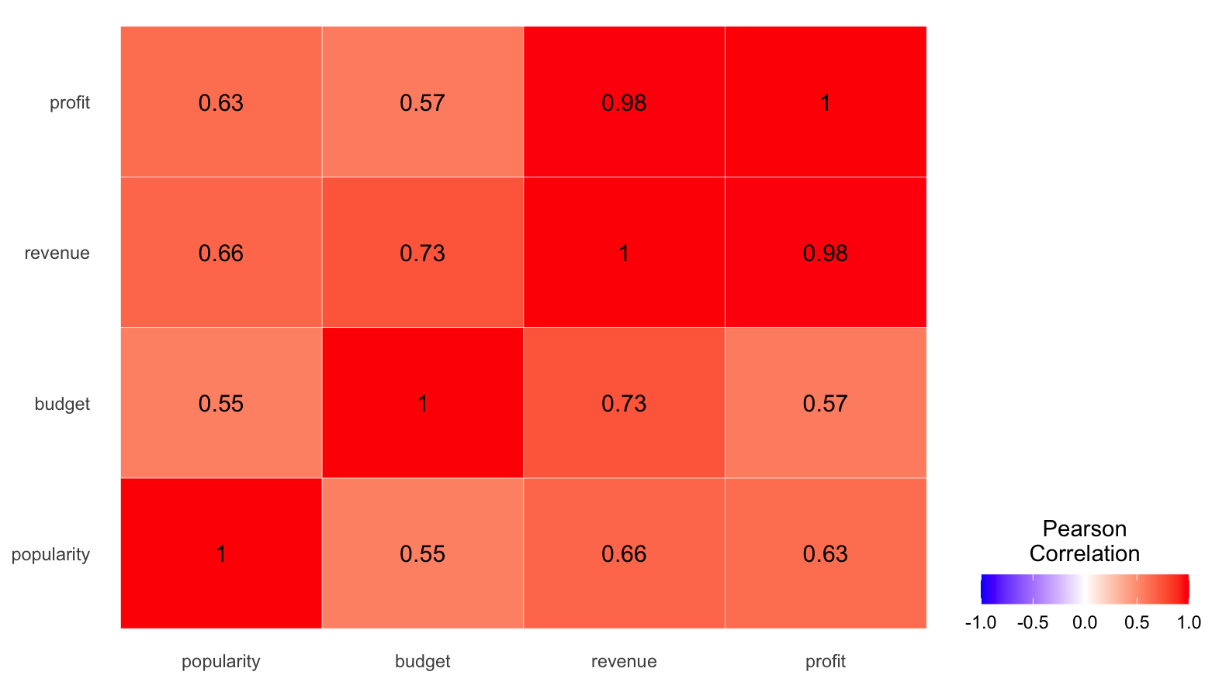
Heat Map

Slide 9
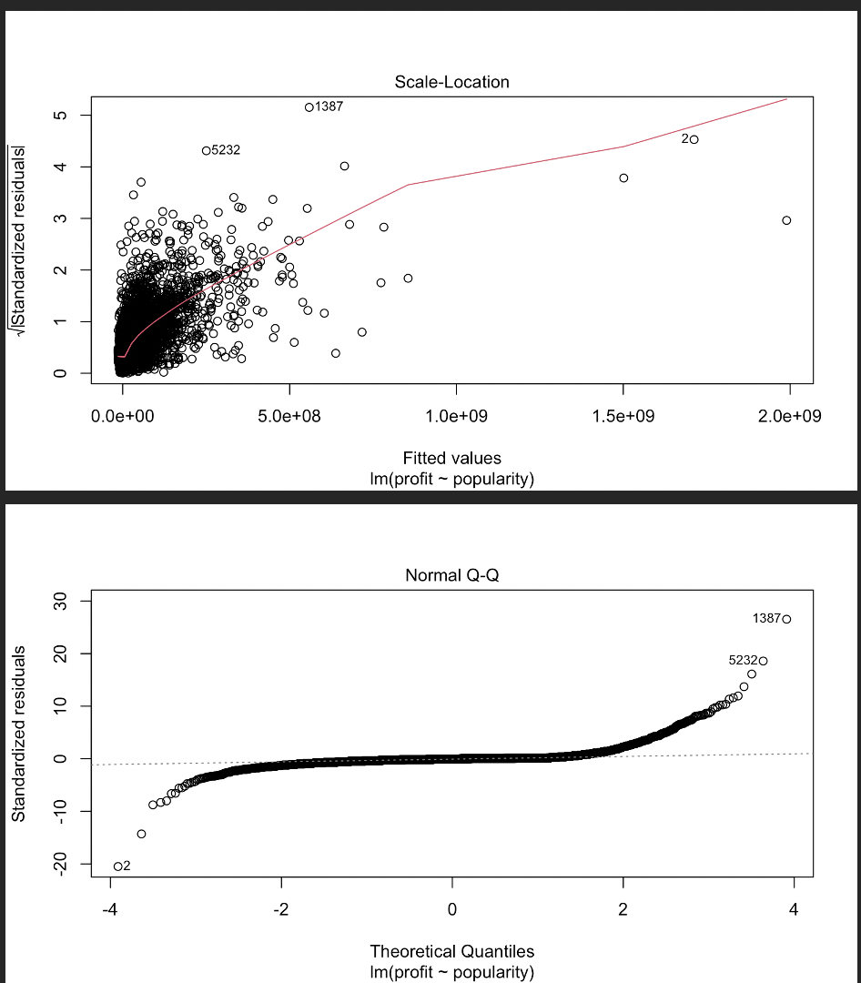
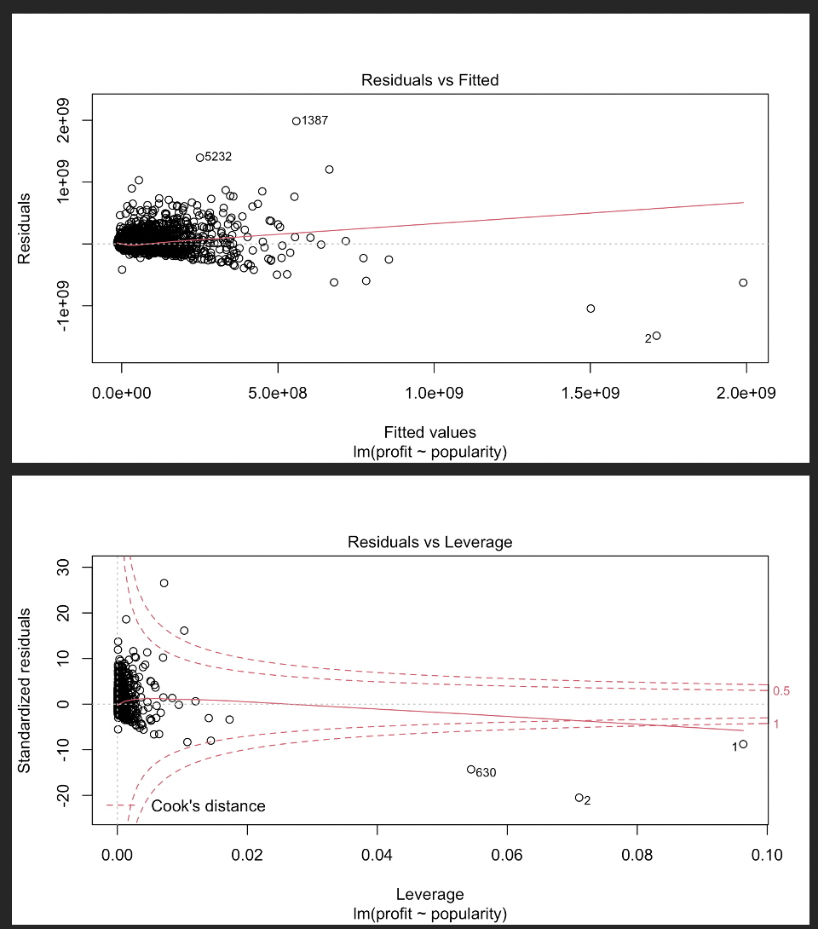
Residual plots

Slide 10
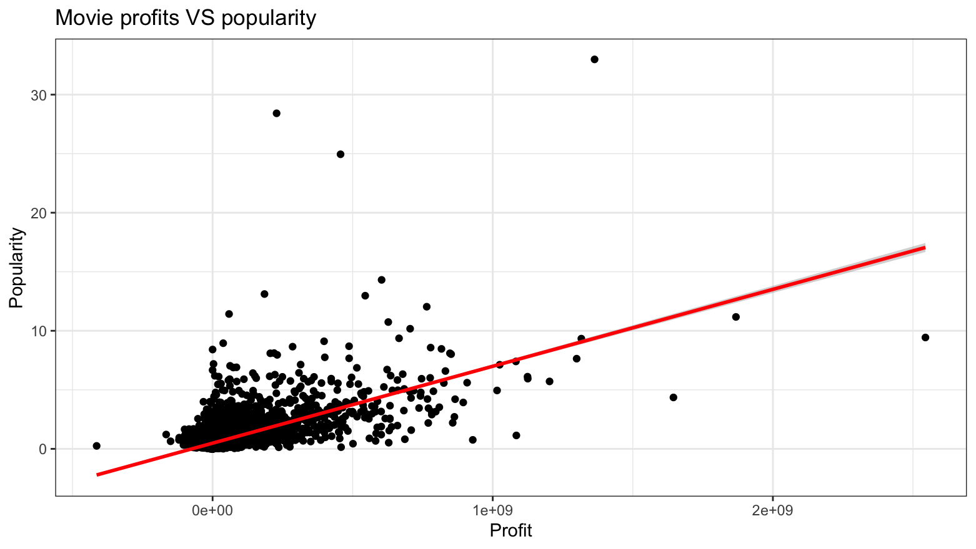
Linear Regression

Slide 11
Analysis of data
Residuals
Close cut in center
Ends veer off and are farther from line of best fit
Linear Regression
Correlation
Variable 1 | Variable 2 | Correlation factor
Popularity | Budget | 0.55
Popularity | Revenue | 0.66
Popularity | Profit | 0.63
Budget | Revenue | 0.73
Budget | Profit | 0.57
Revenue | Profit | 0.98

Slide 12
Summary of data
summary(profit_lm)
Call: lm(formula = profit ~ popularity, data = df1)
Residuals:
Min 1Q Median 3Q Max
-1.484e+09 -1.857e+07 -3.148e+06 7.173e+06 1.986e+09
Coefficients:
Estimate Std. Error t value Pr(>|t|)
(Intercept) -14068309 857754 -16.40 <2e-16 ***
popularity 60741709 720277 84.33 <2e-16 ***
---
Signif. codes: 0 ‘***’ 0.001 ‘**’ 0.01 ‘*’ 0.05 ‘.’ 0.1 ‘ ’ 1
Residual standard error: 75090000 on 10864 degrees of freedom
Multiple R-squared: 0.3956, Adjusted R-squared: 0.3956
F-statistic: 7112 on 1 and 10864 DF, p-value: < 2.2e-16

Slide 13
Issues and Ethical considerations
Uses just popularity to measure film success
Just one rating used (iMDB)
Third hand source for monetary figures

Slide 14
Conclusion
Strong positive correlations
01
Popularity and Budget least related
02
Most movies on low end of linear regression
03
Residuals demonstrate extreme outlier tendencies
04

